Slide 1
Kalbos
kelionė
A Linguanomics Perspective
Gabrielė Hogan-Brun
VDU, Kaunas
gabriele.hogan-brun@vdu.lt
Notes:
Sveiki! Ačiū už kvietimą dalyvauti šiame seminare.
Norečau kalbėti apie savo kelionės su jūsų kalba.
***
This is a story about encounters, opportunities and mutual benefits, through langauge. I shall adopt a practical, pragmatic perspective about learning and using languages. This extends my previous Linguanomics approach to the more general question, Why Study Languages?
You yourselves may not be asked such a question. But in an Anglophone context, where I have worked for most of my life, many people wonder why indeed they should learn another language. So, I have lately been emphasising the cultural gains of knowing languages and am now linking up my personal journey with you.

Slide 2
Tokyo
12th AILA World Congress
(1-6 August 1999),
on:
The Roles of Language in the 21st Century:
Unity and Diversity.
Notes:
The story starts in Tokyo. As is the case with most things in life, there was no master plan. Officially, I was attending the 12th World Congress of the International Applied Linguistics Association (AILA). The topic was, aptly: ‘The Roles of Language in the 21st Century’. This is always a major event, with several thousands of participants.
I stayed at a nearby youth hostel. By chance, a Lithuanian delegate happened to be sharing my dorm. Naturally, we got talking…and are still doing so today! Some of you may know who this is…
I remember being struck back then by Meilutė’s story about the recent changes in her country. What she told me had a sense of immediacy, of urgency. I vaguely remembered some TV footage about Baltic events I had seen some years before and realised there was a case to follow up.
Back at work in Bristol, I successfully obtained research funding from The British Academy for a joint research project on the language situation in Lithuania.

Slide 3
The place.
The language?
Notes:
However, I had never been to the Baltic region, let alone Lithuania (to be honest, I had to look it up on the map first). I wanted to find out about the place, so I bought this guide. Its book cover struck me, quite frankly, as a bit strange. But it aroused my curiosity. I felt I needed to learn the language, to get to understand this Lithuanian culture.

Slide 4
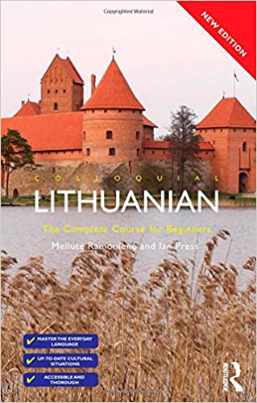
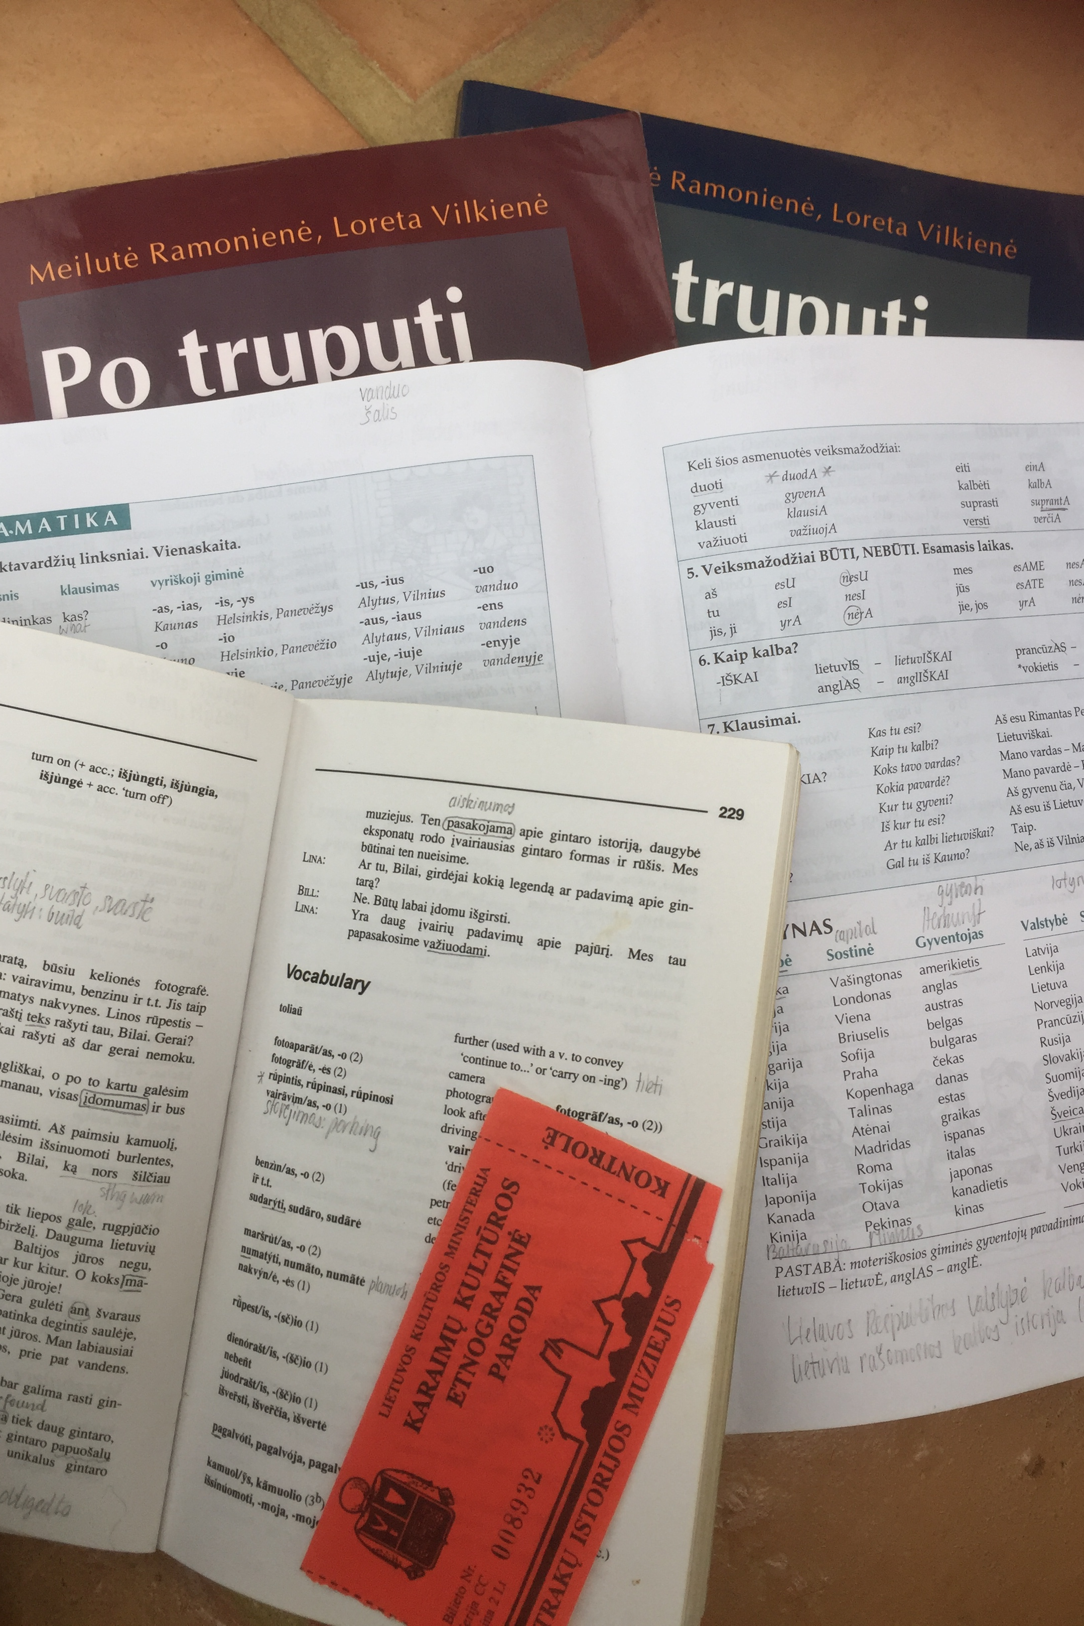
LITAKos seminaras – 2022 sausio 25
Notes:
These language books were a good preparation before visiting Lithuania. I enjoyed the systematic approach they offered. There was an element of a story too, and I soon wanted to find out about the progress of the relationship between Aldona and Bilas, who I think was a fictional American visitor.
Studying Lithuanian felt like reactivating years of school Latin. I had always enjoyed Latin and its grammatical complexity. Reviving this now was demanding, but also fun.

Slide 5
Why study languages?
Reasons for...
Facts about…
Benefits of…
Notes:
So, I had my reasons to learn Lithuanian. A connection had been formed through a chance encounter, on the other side of the globe. Our exchange aroused my curiosity and, in due course, deep interest in the culture, the language, the people.

Slide 6
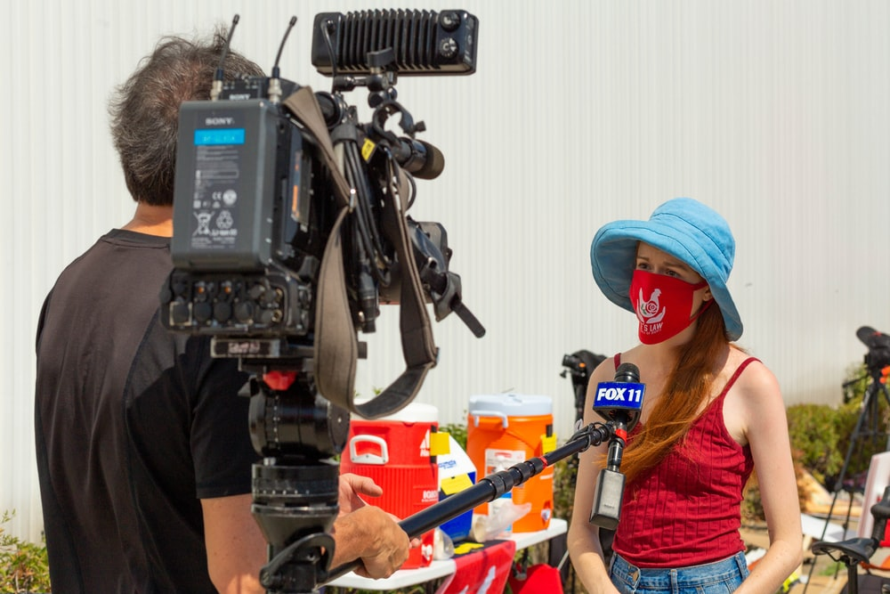
Personal stories
#Curiosity
#Creativity
#Inspiration
# Passion
#Utility
#Curiosity
#Survial
#Perseverance
#Connection
Notes:
In a way, my experience with Lithuanian inspired me to accept a recent invitation to write a book, on ‘why study languages’? I decided to populate it with the personal stories of people from different walks of life, both ordinary and famous. Among them are students, artists, migrants, reporters and managers. The point was to show what drove these people to learn languages:
For them, it was:
…curiosity to find out things… it was creativity, and idealism
…it was also passion, for a language or a culture
…and perseverance, as in sports
…for some it was utility and career expectations
…all of which allowed these individuals to achieve, connect, survive…or fulfil a dream.

Slide 7
# Perseverance “Becoming multilingual sharpened my brain and reflexes”
#Inspiration
“The flavour and the language are linked”
Notes:
Let me briefly introduce two of these individuals on their language journey - we meet:
Tommi Myers she is a prize-winning Chef & founder of the Wahaca restaurant chain. She says:
‘There’s this whole resonating kind of language going on that draws you in. The flavour and the language are linked, because the taste, the memory and the words are all bound up into one’.
Then there is Grand slam winner Martina Navratilova who says:
‘Two ‘passports’ expanded my horizons, transformed my life and opened up the world: ‘the game of tennis and languages…. Becoming multilingual has sharpened my brain and reflexes.’

Slide 8
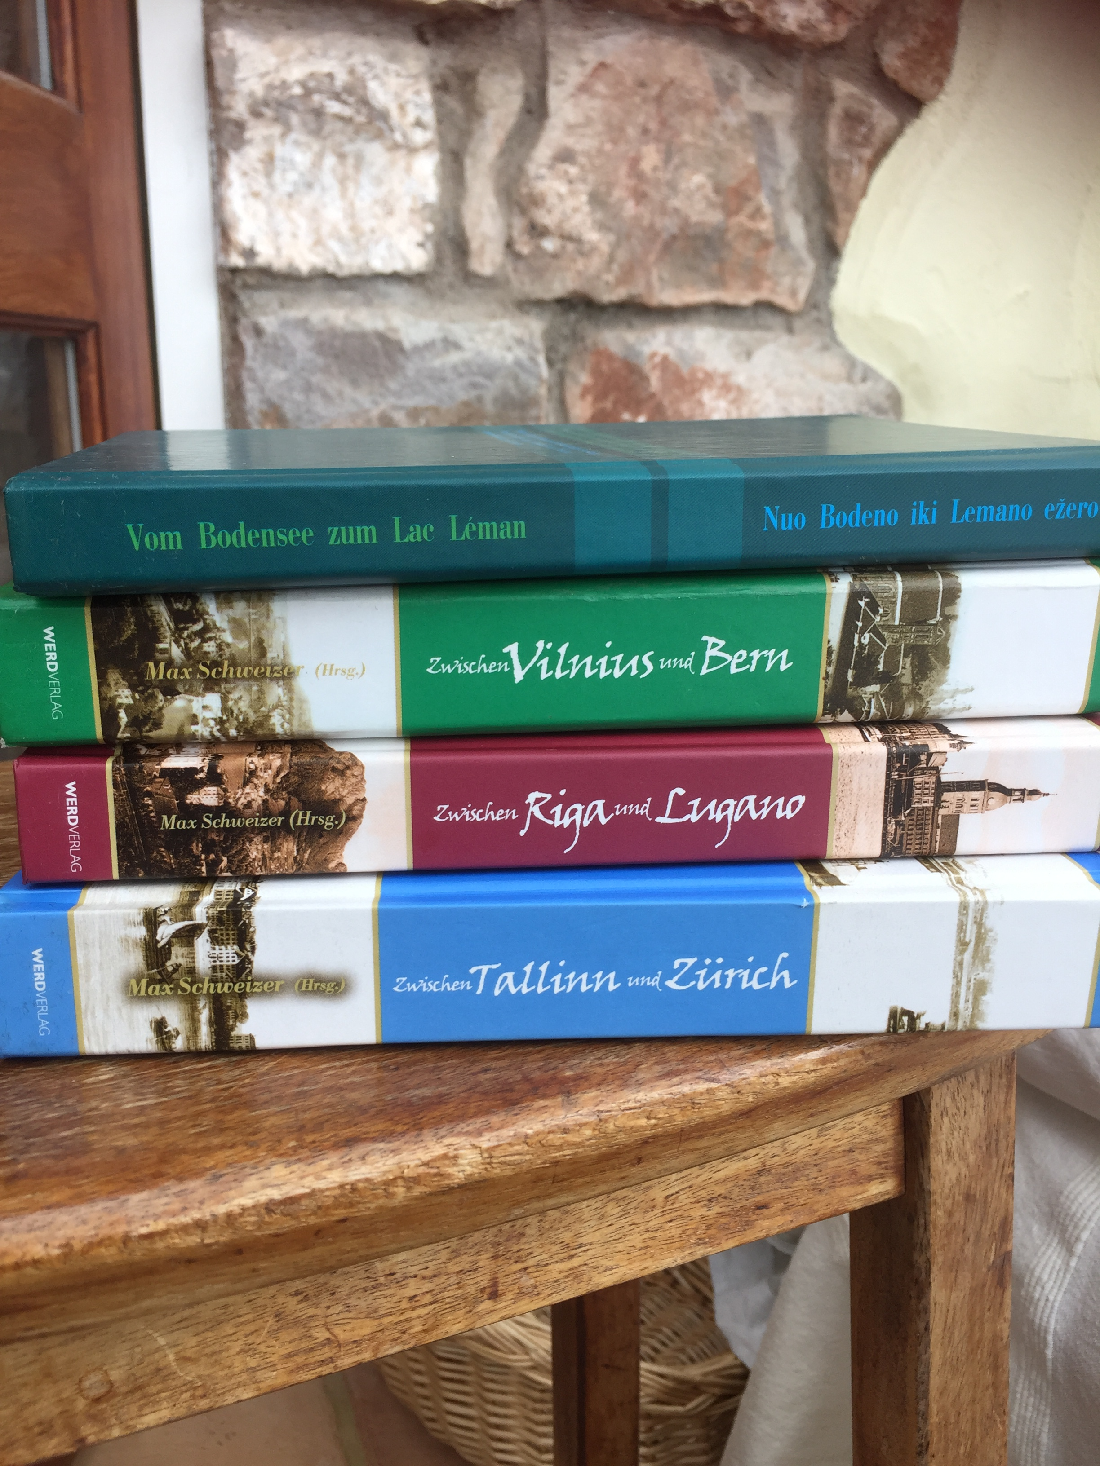
On our journey…
Notes:
Going back to my own story, I was curious about other meaningful connections I could make with Lithuania. So, I looked into past links between Lithuania and my own country, Switzerland.
And indeed, there were several Swiss-Baltic cultural ambassadors and stories.
As for myself, I had grown up near Berne and was now preparing for my first of numerous visits to Vilnius, and subsequently also to Riga and Tallinn.

Slide 9
Ant ežero keturių kantonų - Maironis
Ežero skaisčios bangos liūliavo
Žaliu smaragdu;
Laivą be irklo varė, lingavo
Vėsos dvelkimu.
Saulė už Alpių leidos sutingus;
Varpai Liucernos
Dievui aukojo darbus vargingus
Žmogaus ir gamtos.
.
Notes:
I soon found out about your very own poet, Maironis. I read his poem about the lake of Lucerne with a translation and liked it from the start – it’s a beautiful lake, and one I know well, from swimming, and rowing:
Ant ežero keturių kantonų …
He really got the atmosphere right! In fact, as I came to find out later on, our countries’ genuine love for nature is one of the main elements that connects us.

Slide 10
Why study languages?
Reasons for...
Ways of studying…
Benefits of…
Notes:
So, the more I learnt about the country the more I wanted to learn the language, and vice versa. But things were still a bit abstract, and the language wasn’t widely available yet on the internet back then. I had to visit the place.
I secured time and the resources to visit. Now, I had the chance to savour the language all around me.

Slide 11
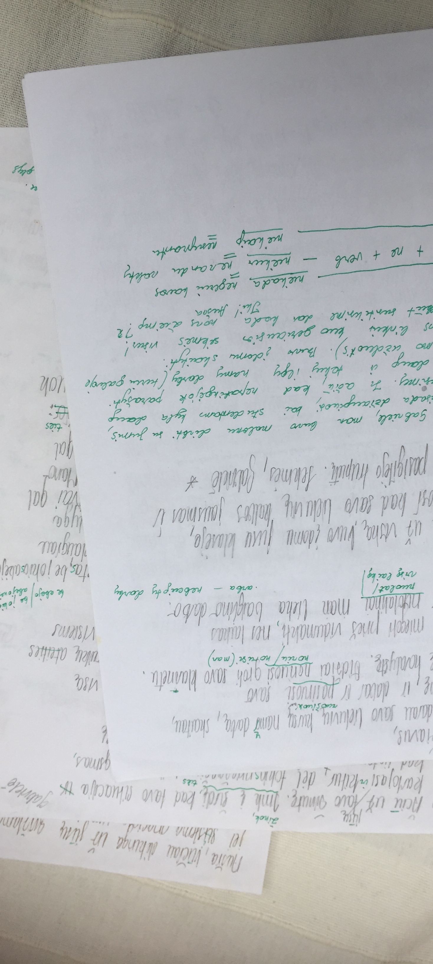
Immersion
Lituanistikos kursuose
Notes:
…I still remember trying out my faltering Lithuanian on my first visit to the country. Happily, people seemed to understand me when I spoke some simple sentences and even replied in their language when I asked a question. It was such a reward!
I enjoyed learning the language at VU and loved the depth of total immersion, the focus on the structure of, and productivity with, the language.

Slide 12
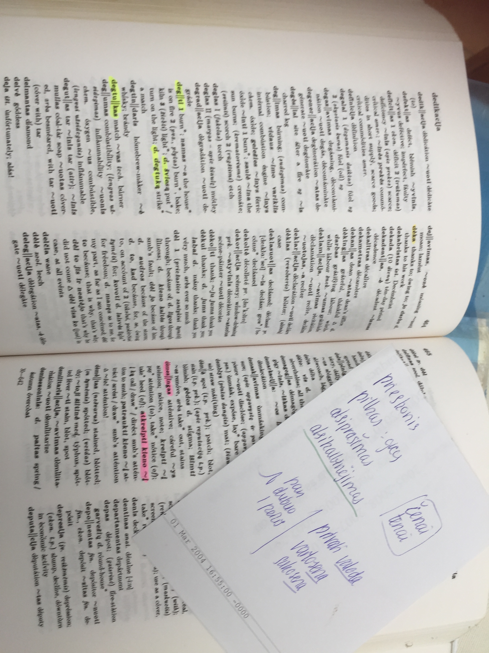
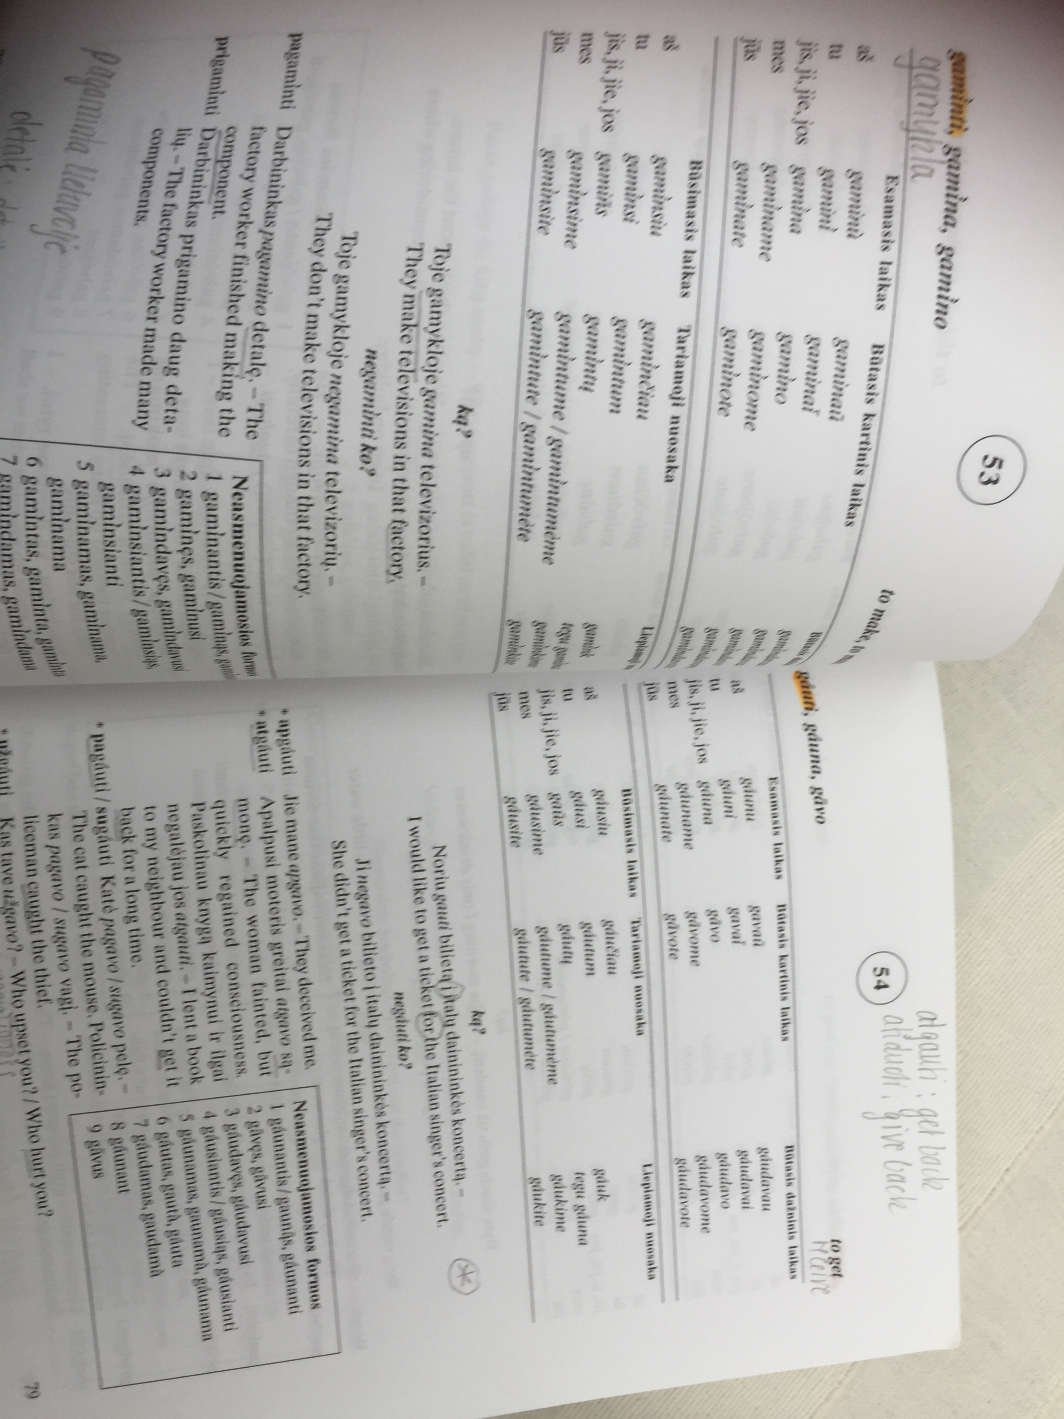
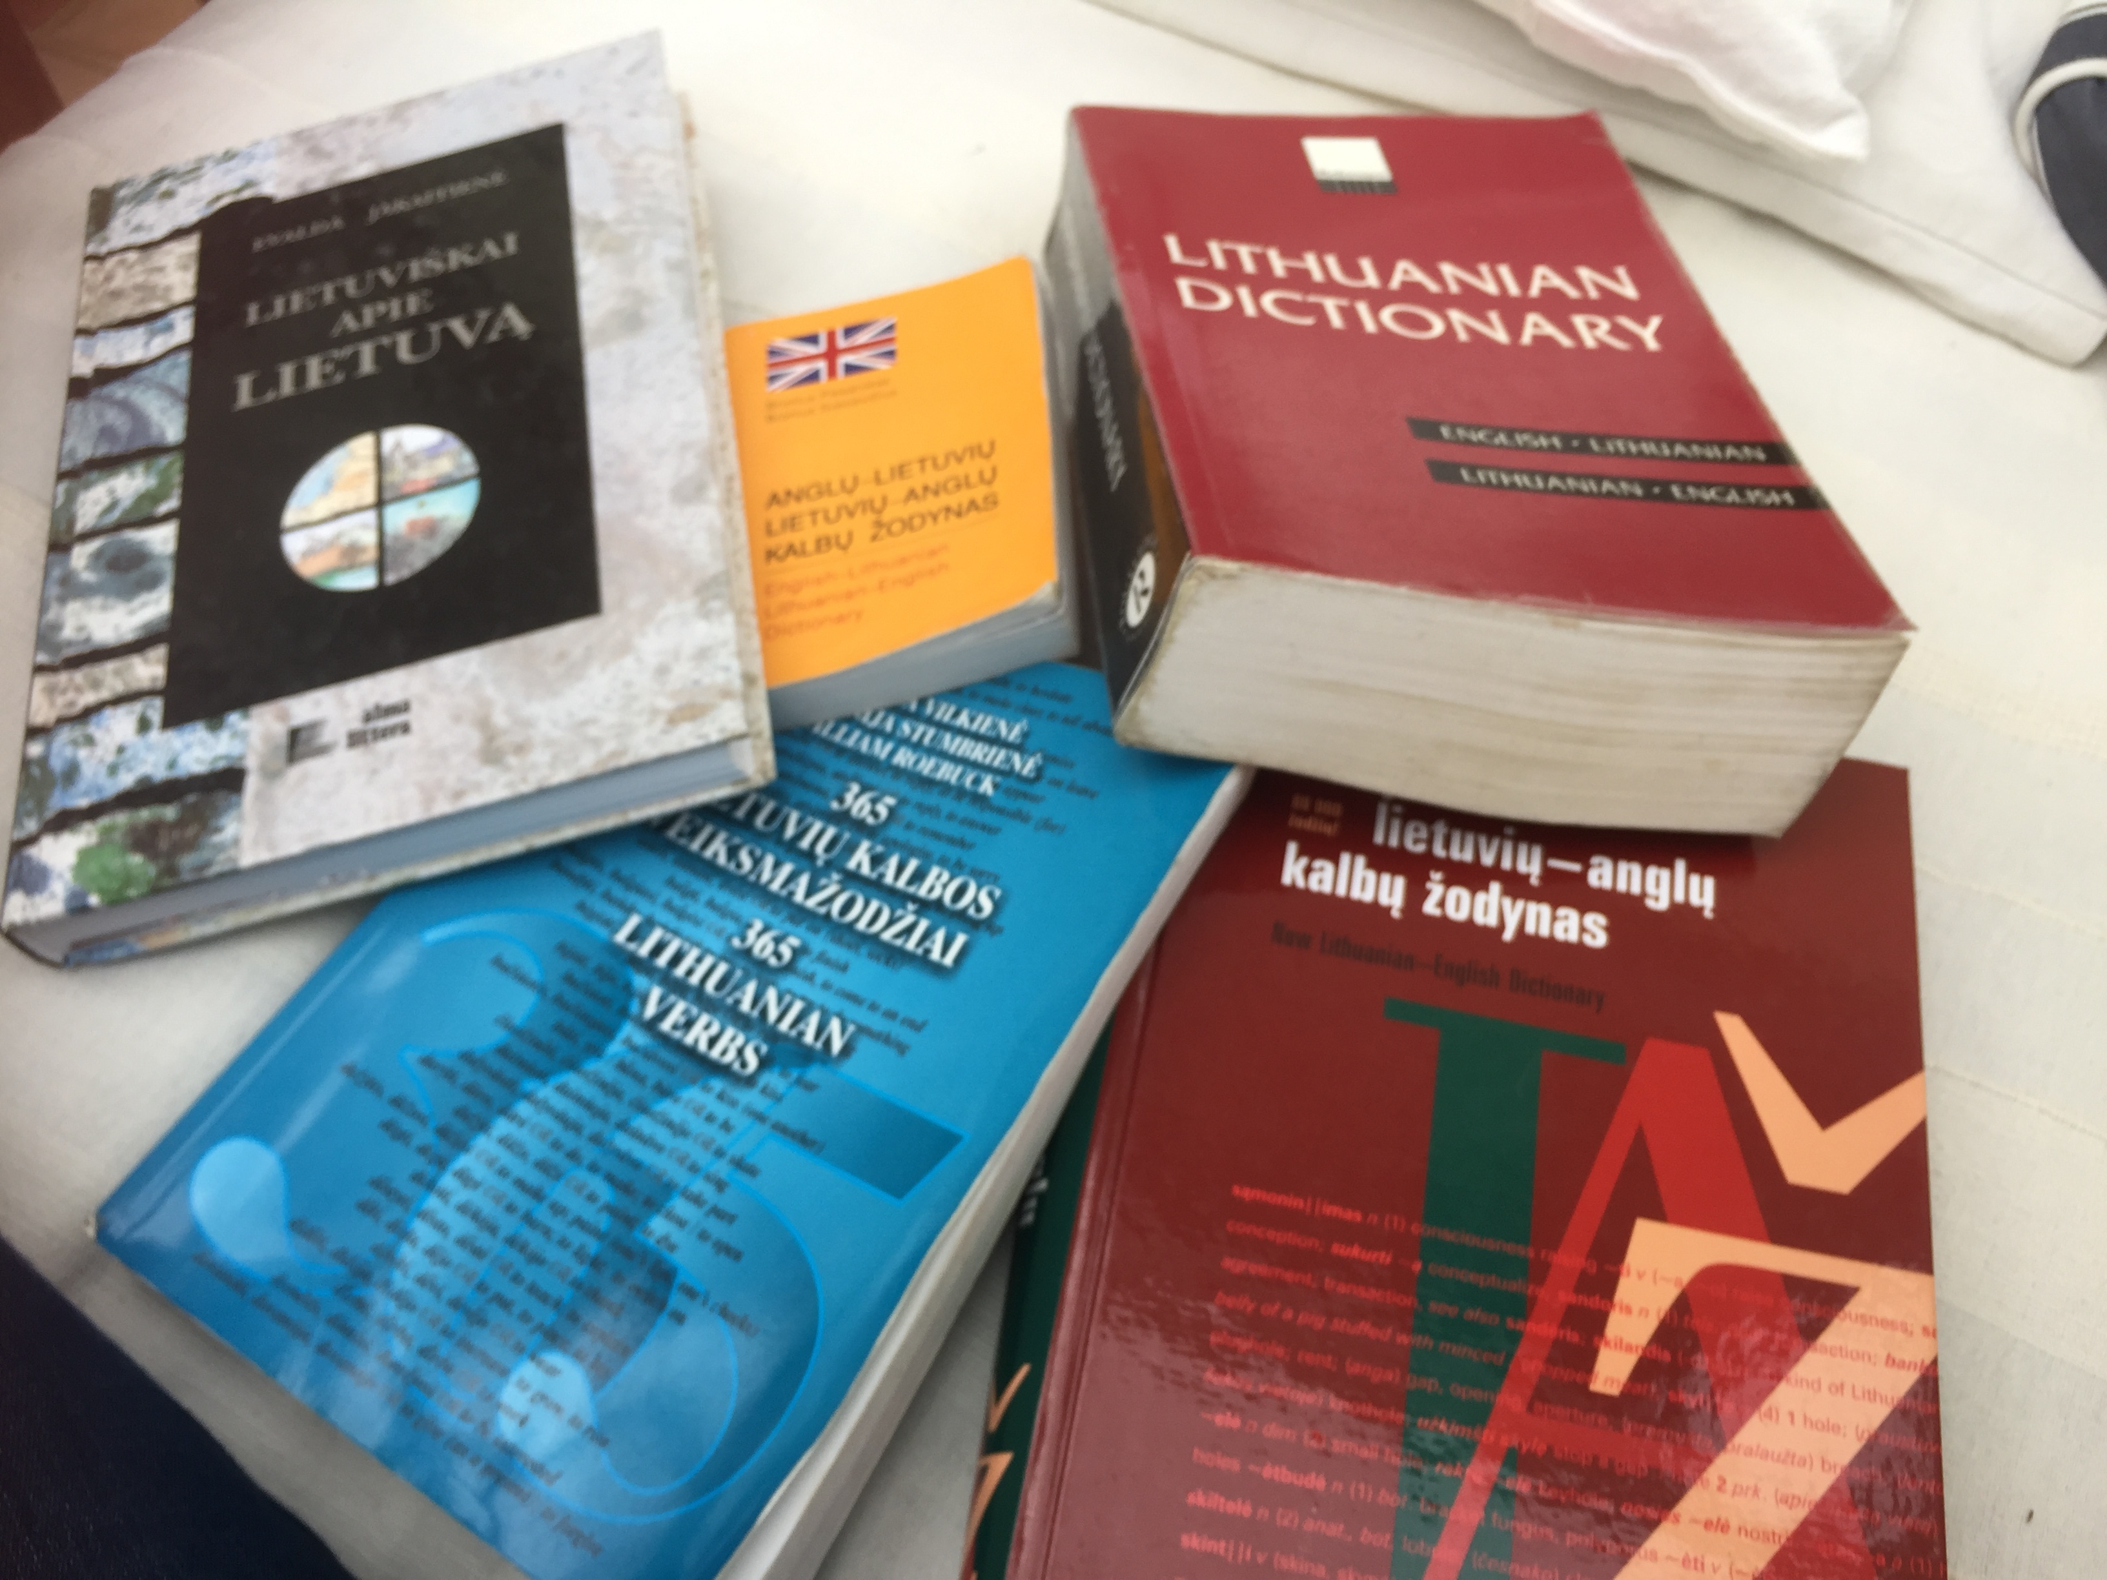
Self-study
depth
systematic learning
…being a student again 😄
Notes:
I stocked up on various language materials for systematic self-study.
It was great being a student again!

Slide 13
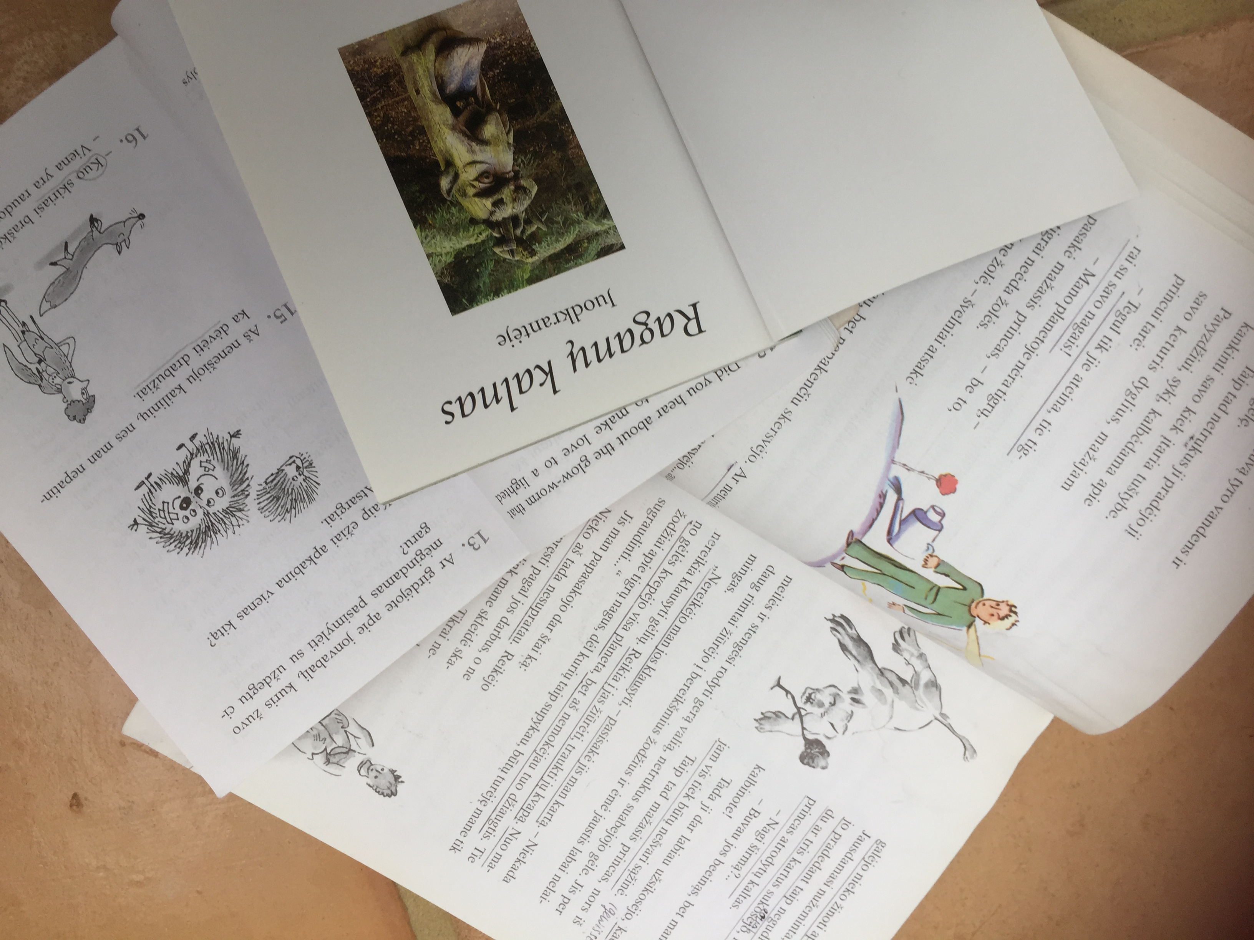
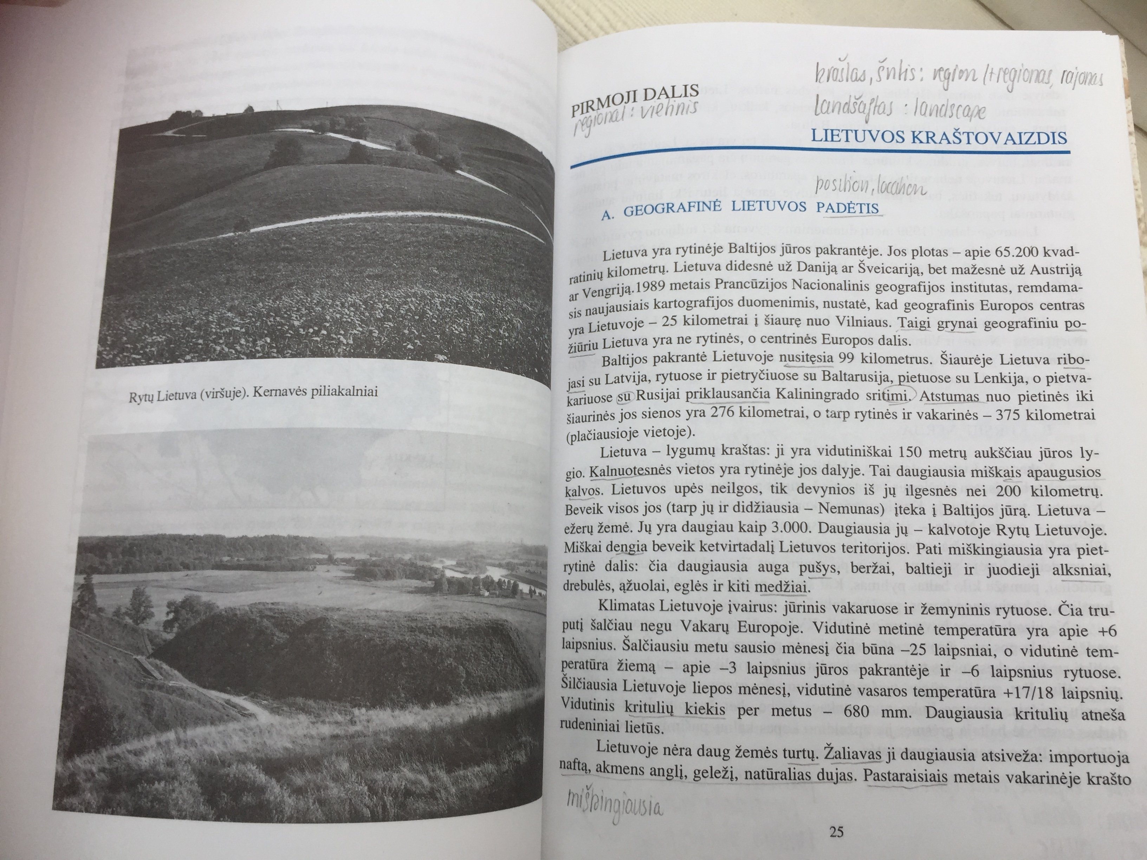
Reading everything
Notes:
I read everything I saw, public notices, street signs, adverts, scribbles on toilet walls, inscriptions on grave stones…All these short texts were of course in different registers, showing me different ways of language being used in different contexts.

Slide 14
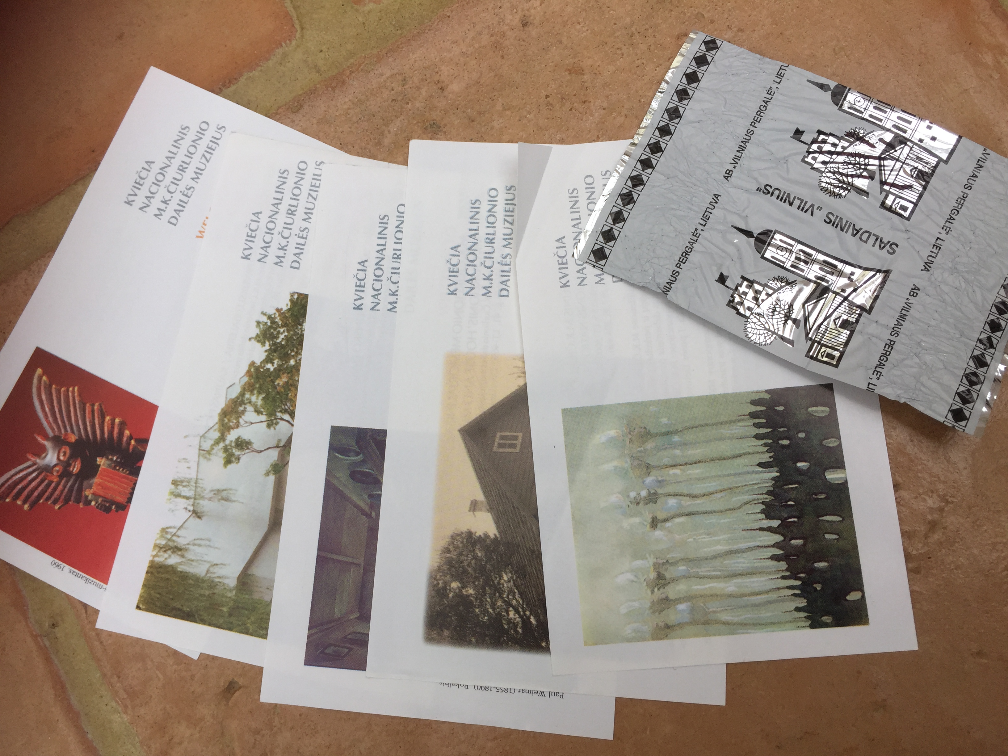
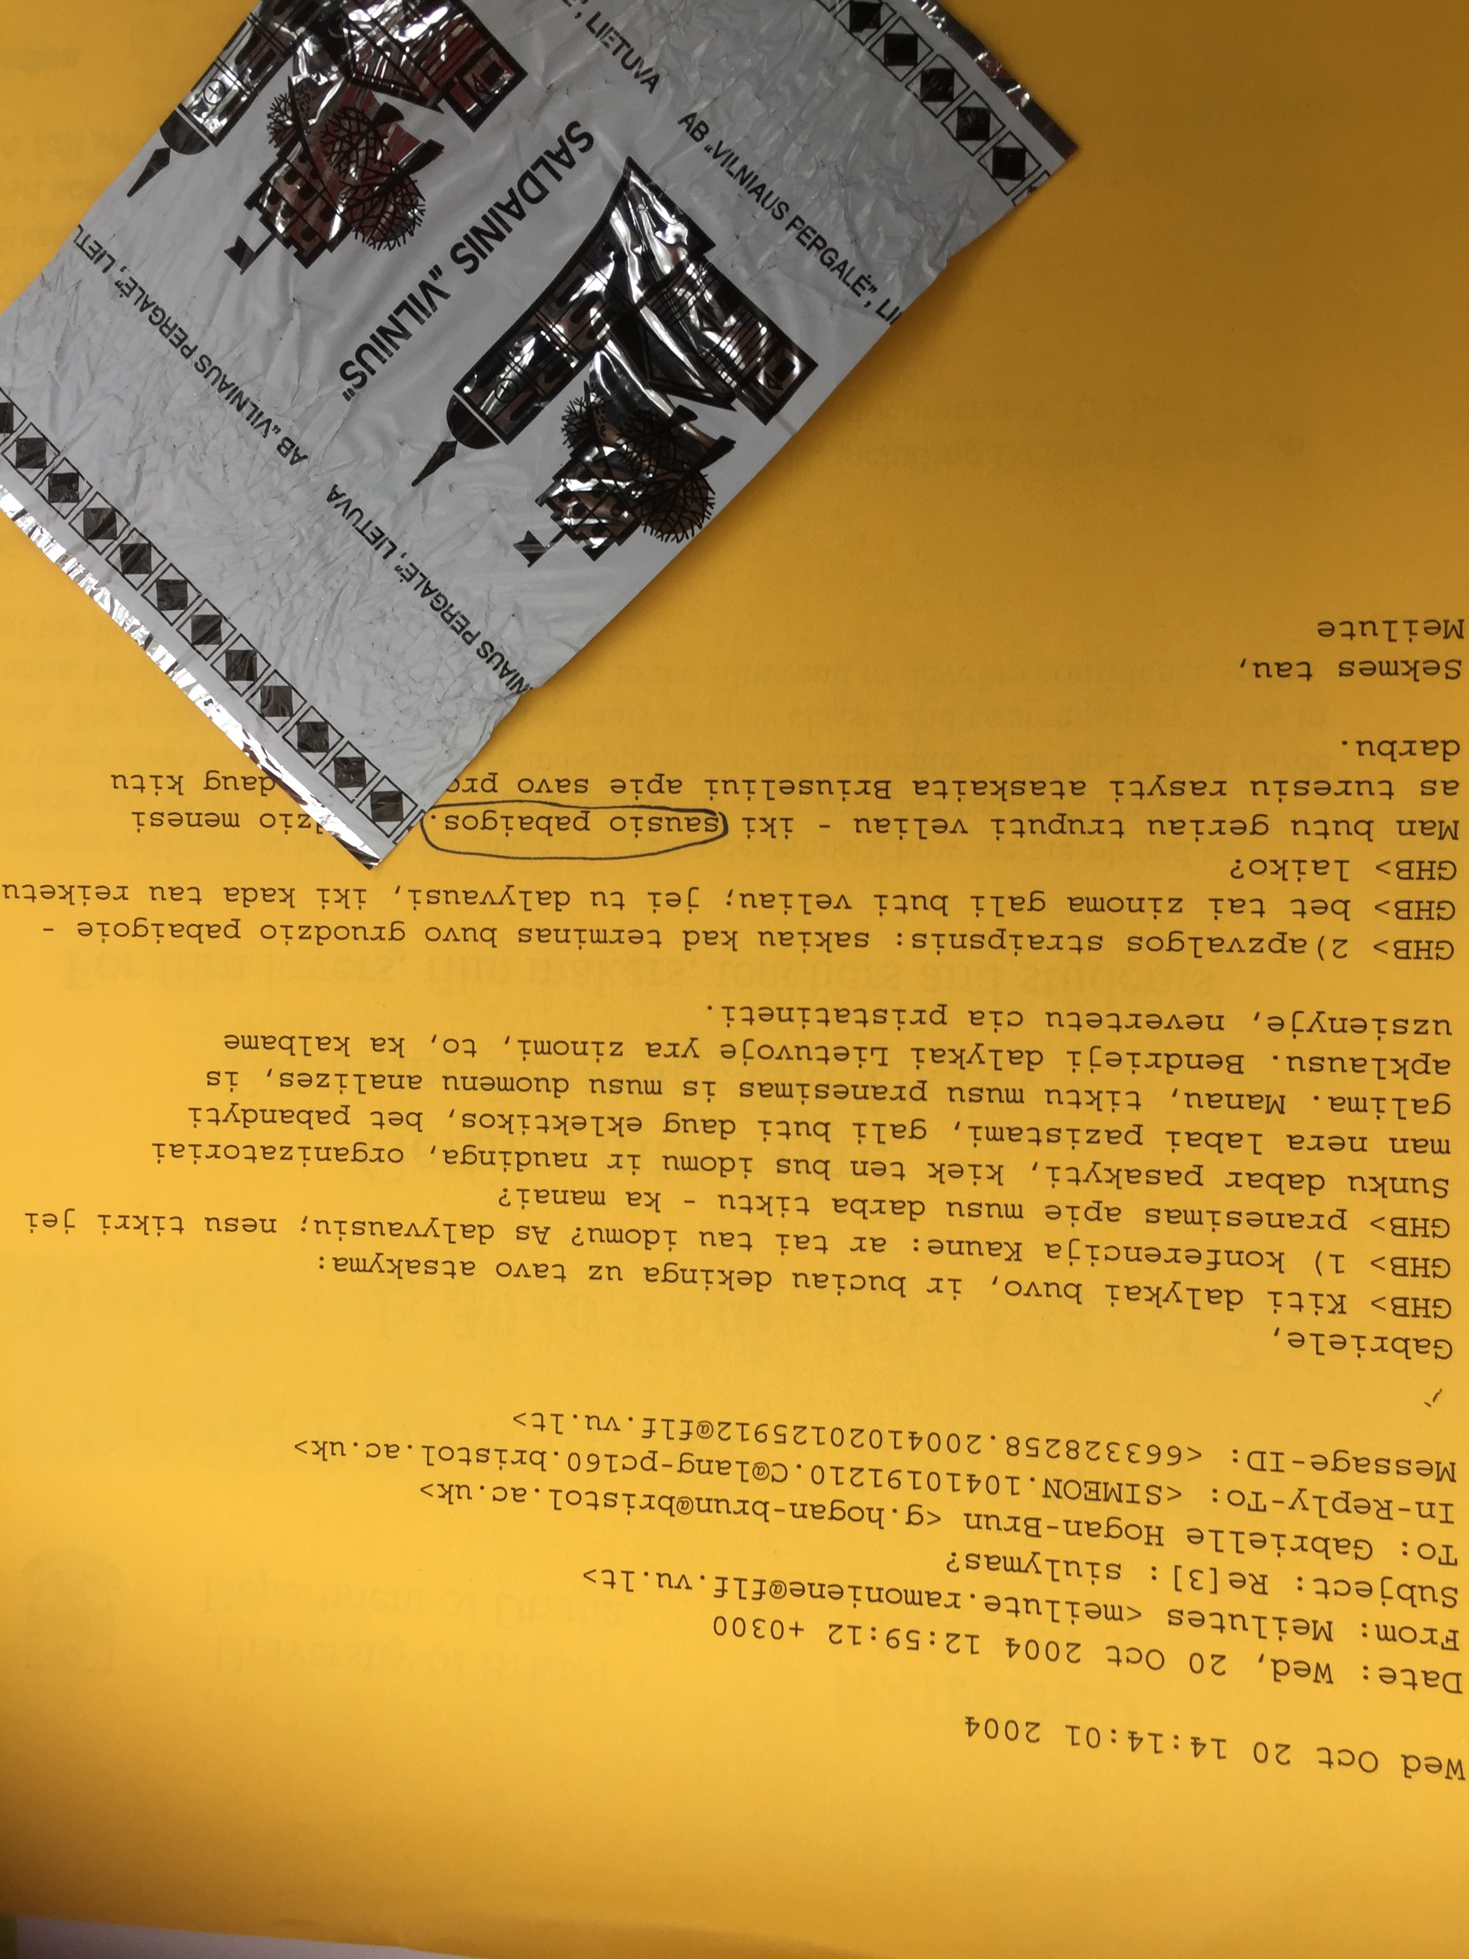
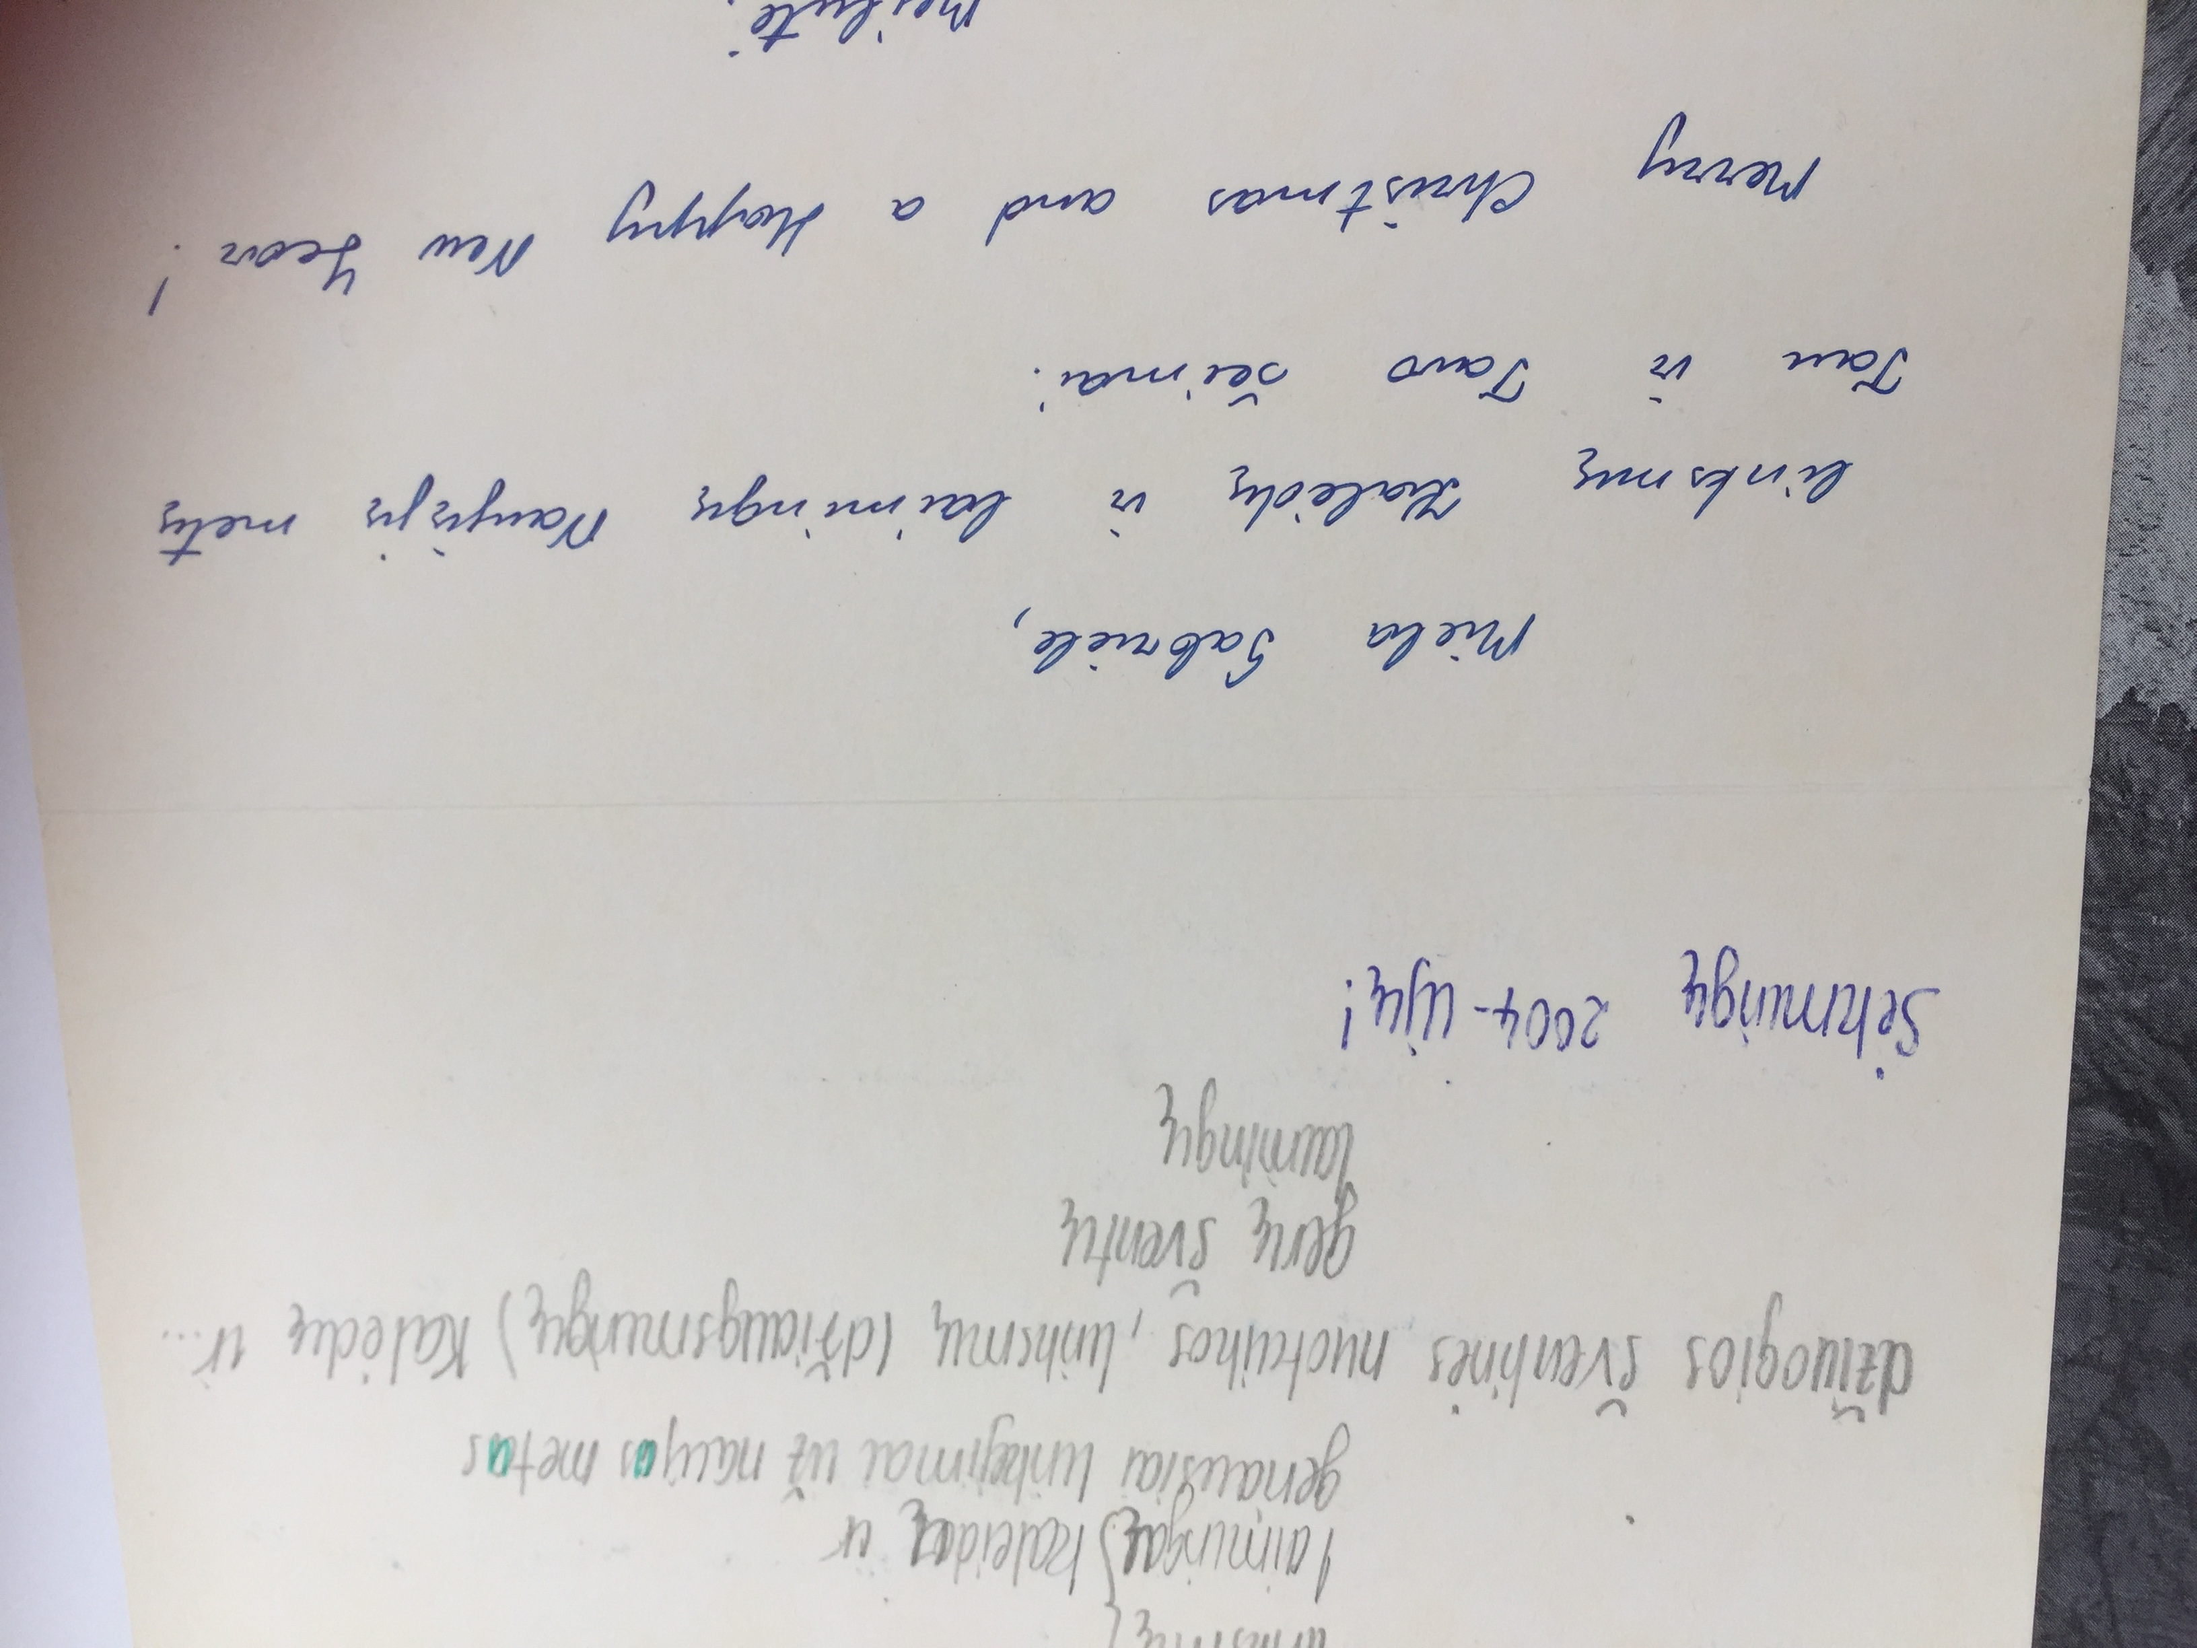
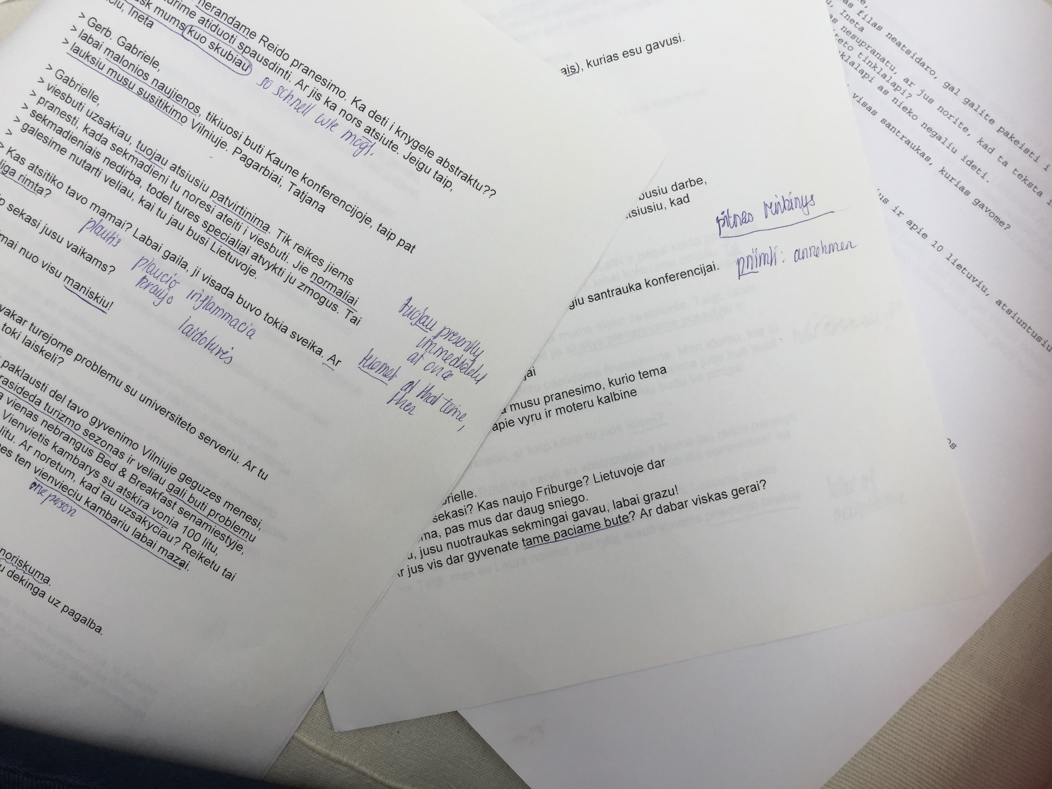
Collecting items & mail
Notes:
Also, I collected everything with writing on, tickets from museum entries, from concerts, sweet wrappings, whatever I could lay my hands on was interesting!
… and I learnt turns of phrases from emails and cards I received. Little by little, I started to be able to compile sentences for specific purposes.

Slide 15
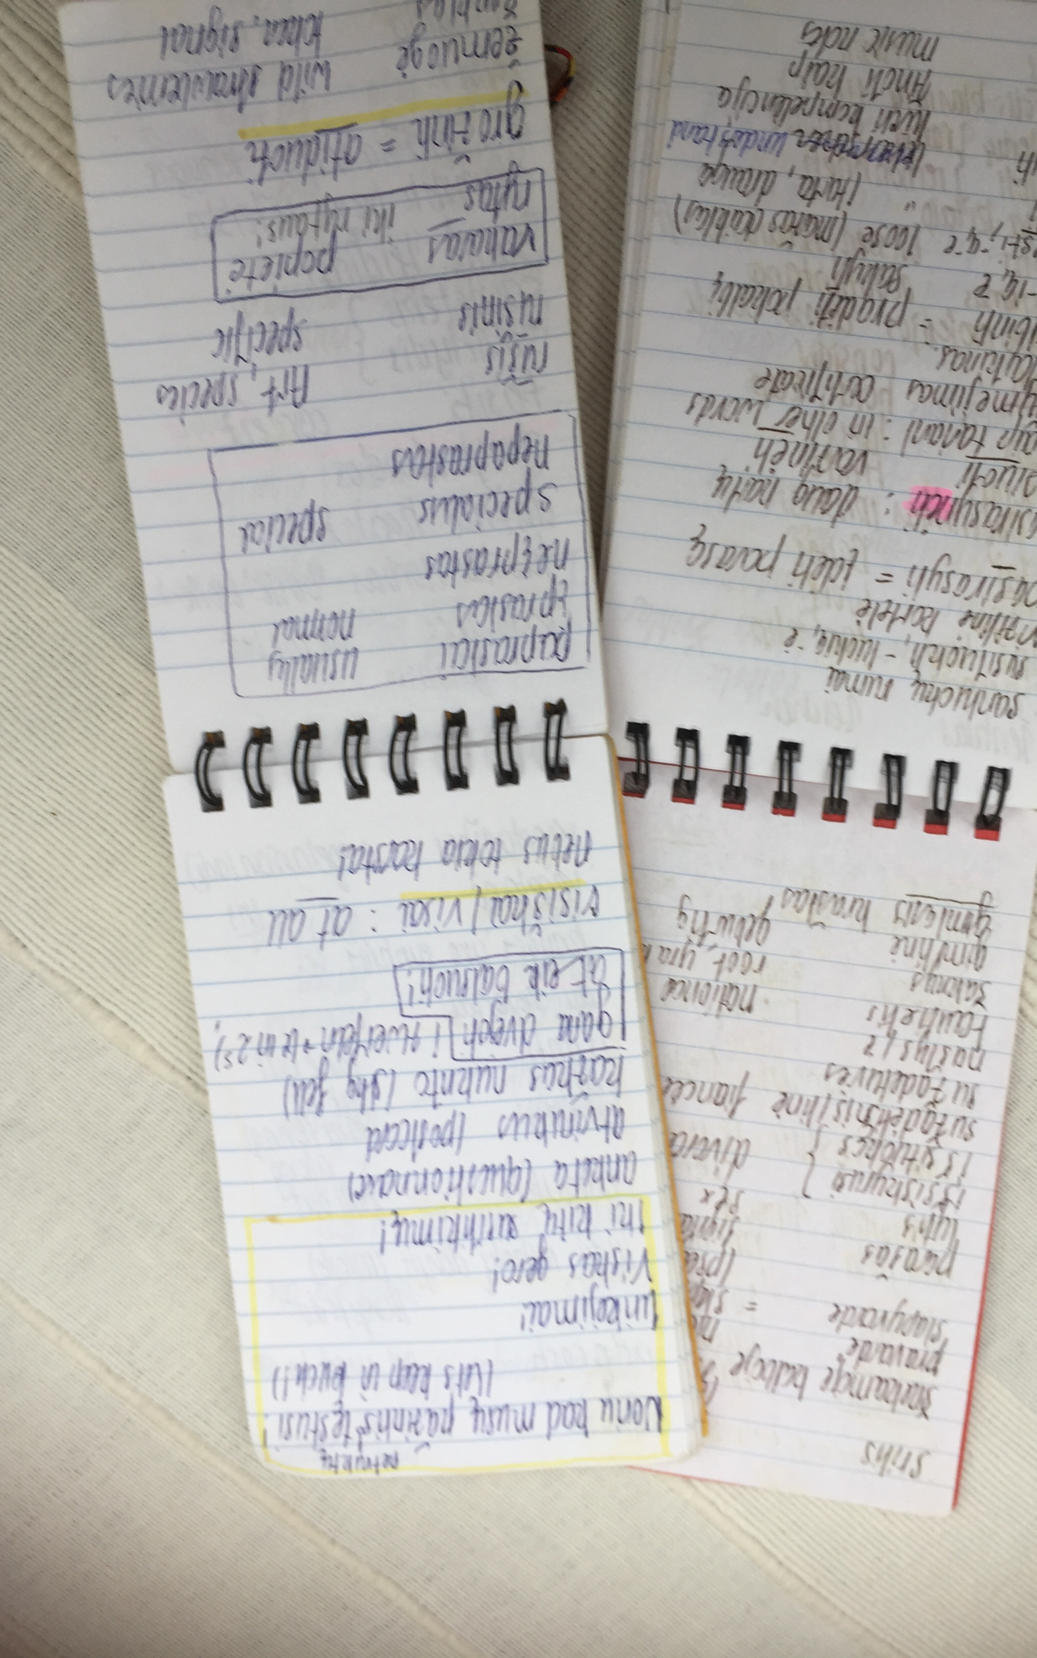
Taking notes
Notes:
Practically, I took notes, wherever I went. In the early noughties, my notes consisted of handwritten entries in small notebooks. I always carried these around with me, wherever I went. Nowadays, I tend to compile such personal language lists on my iphone.
These entries in my notebooks became steadily more complex as we started collaborating on our Lieutuvių kalbos projektas.
I was all go, and I was so motivated!

Slide 16
A milestone …
Notes:
In due course, I ended up with two very venerable certificates!
A nice recognition, but for many of us, learning is a life-long journey of discovery (and my journey certainly didn’t end there).

Slide 17
Ways of studying… languages
Bitesize, little by little, frequently
Systematic language learning; note-taking
From core knowledge to periphery
Apply language skills to own life & needs
Why Study Languages?
Notes:
I decided to note down some of my language learning experiences as reflections in: Why study languages?
Overall, I had experienced once more that learning is best done
- in bitesize portions, little by little, but frequently….
and by getting to grips first with the core, in a systematic way
before branching out to the periphery, as relevant to life’s needs.

Slide 18
Taikomoji kalbotyra
apklausa, surašymas, duomenys, gyventojai, kalbų mokėjimas, lietuvių, rusų, lenkų kalbos, tutešių,
daugiakalbystė,
švietimas, šalis, tapatybė, i.t.t.
...
Why Study Languages?
Notes:
Going back to our chef, Tommi Myers, she will soon have wanted to know the Spanish names of different spices on her culinary journey. She will have been keen to talk about different flavours and dishes with chefs, her clientele, her friends. So, she was developing some expertise at the periphery.
This is just as I was doing when I was branching out in Lithuanian to talk about applied linguistics. We started on our project on lietuvių kalba, and I learnt about taikomoji kalbotyra. This was a steep learning curve; now I was learning lots of new words:…
As I found myself branching out into this periphery, I had to still maintain a sense of proportion and securely be able to return to the core, the stuff of everyday life: For example, when buying my favourite bread (juoda duona su kuminais), or finding out about everyday things.

Slide 19
Why study languages?
Reasons for...
Ways of studying…
Benefits of…
Notes:
What were for me the benefits of studying Lithuanian?
A new outlook, lasting friendships, deep insights into local ways of being and doing things, culture, language, arts, and now, decades later, being invited to join VDU.

Slide 20
“…speaking more than one language helps make you a better person too”.
“…has shaped my entire career has shaped what I have done with my life”.
Notes:
Let’s see what our protagonists say about their benefits: Tommi Myers, our chef, said:
‘That one decision to learn the Spanish language has shaped my entire career has shaped what I have done with my life’ .
And the tennis legend Martina Navratilova says:
‘Beyond tennis, I think speaking more than one language helps make you a better person too.’
I felt that such statememts about cognitive, personal, and also material gains might help motivate monolingual individuals to learn other languages.

Slide 21
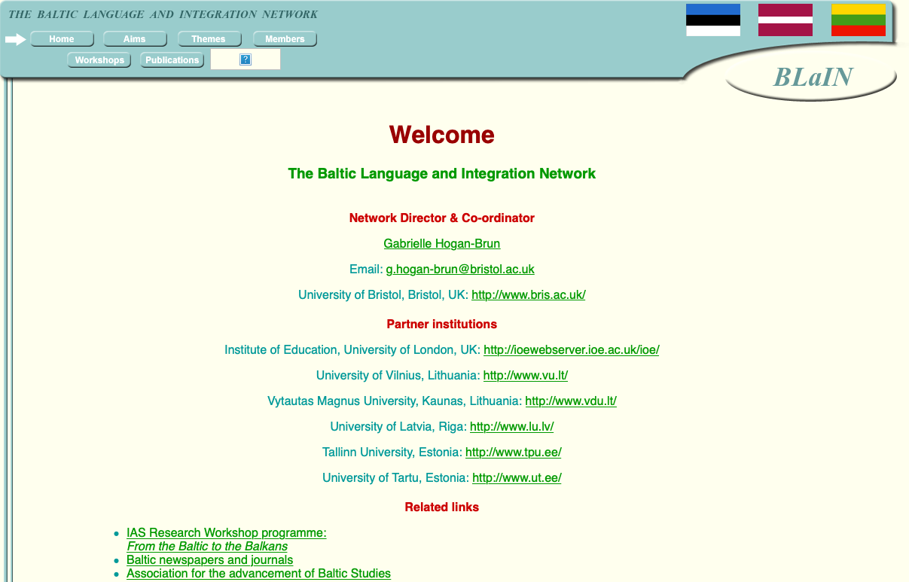
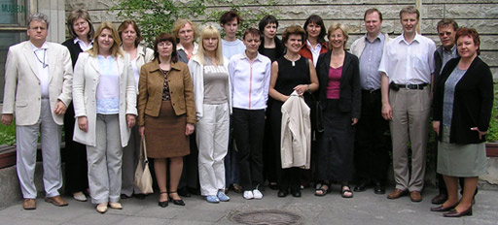
Cross-Baltic Research Network
Notes:
Going back to my own story, learning Lithuanian has certainly given me a new direction, professionally. I enjoyed collaborating on issues of language policy and practice in, for me, familiar multilingual settings.
Further funding then led to the foundation of a cross-Baltic network (BLaIN) to share ideas and experiences about language issues. In annual workshops held in Vilnius, Riga,Tallinn, Kaunas, we enjoyed many fertile exchanges. You may still recognize some of these faces, although that’s now quite a while ago…

Slide 22
Cross-Baltic collections
***
Baltic national Applied Linguistics Associations
Notes:
So, this is turning out to be a bit of a collective celebration.
This networking strengthened Baltic applied linguistics and led to the foundation of national applied linguistics associations -- Litaka in Lithuania, LLVA in Latvia and EAAL in Estonia.
These cross-Baltic activities also resulted in a number of published collections at the international level, in the Journal of Baltic Studies (XXXVl/3, 2005), the Journal of Multilingual and Multicultural Development (26/5, 2005), and in Current Issues in Language Planning (vol. 8/4, 2008), to name just a few.

Slide 23
Language Dynamics Research
Language policy & acquisition
language behaviour at the micro-level
greater number of domains
focus on language diversity
-> approaches to multilingualism.
Notes:
I can flag up at this stage a comparative overview of more recent research emphases (since 2010) and future directions across the Baltic (the full reference to this is on the last slide).
Overall, the chapter reports on a diversifying scholarship in applied linguistics, across the Baltic. Obviously, language policy and planning, as well as language acquisition still feature highly as topics in many publications. But there is now also more sociolinguistic work being carried out, particularly on language behaviour at the micro-level, on language use in a greater number of domains, and on language diversity.
Looking ahead, further work could perhaps focus more on approaches to multilingualism in our rapidly changing world.

Slide 24
Languages…
are a resource that’s in demand
have value
have the power to shape our life, our future.
Why Study Languages?
Notes:
In conclusion, I see languages as a resource, in all spheres of life. I stress in my work that ALL languages, big and small, have value, for individuals, societally and also economically. The Linguanomics perspective I have adopted lately proposes an appreciation of both the social and material potential of languages.
Let me briefly share with you a quote by one reviewer, who smartly suggests: Languages have the power to shape our life, our future!
And, we all can benefit from their diversity.

Slide 25
Dėkui
Language Dynamics Research in the Baltic States. In: Ball, M.J. & R. Mesthrie (eds),
The Routledge Handbook of Sociolinguistics around the World. (2nd ed., forthcoming 2022).
Why Study Languages?
(London Publishing Partnership, 2021).
https://londonpublishingpartnership.co.uk/why-study-languages/
Linguanomics.
What is the Market Potential of Multilingualism?
(Bloomsbury Academic, 2017).
https://www.bloomsbury.com/uk/linguanomics-9781474238298/
Notes:
Ačiū jums!

